Slide 1
Cell organelles
Mitochondria (powerhouse of cell)
Ass.prof.Dr.Emad Kudhair Abbas
Ph.D. Molecular Cytology

Slide 2
Learning objective
1-Define of different organelles in cell
2-Strucutre and functions in these organelles
3- Abnormality organelles functions

Slide 3
Case Study
4 years old boy presents with recurrent attacks of breif jerky movement of both upper and lower extremities , with unsteady gait. His oldest sister have MERRF
syndrome( rare mitochondrial inherited disease affects brain and muscles due to impaired mitochondrial functions ), what is the mitochondria.

Slide 4
History
  Mitochondria were first seen by kollicker in 1850 in muscles and called them ‘sarcosomes’
  Flemming (1882) described these organelles as ‘filia’
  Altmann (1890) observed these structures and named them ‘bioblasts’.
  Benda (1898)stained these organelles with crystal violet and renamed them ‘mitochondria’
  Michaelis (1900) used janus green B as a vital stain to observe mitochondria in living cells.

Slide 5
What meaning of mitochondria ?

Slide 6
Mitochondria
Are membrane-bound organelles lying in the cytoplasm. They are spherical or filamentous (rod- shape) structures with the size about (0.5- 1μm) wide with length up to 10μm.

Slide 7
What the characteristics feature of mitochondria ?

Slide 8
The characteristics feature
●The mitochondria vary in number with cell activity.
●They found in few numbers in lymphocytes and epithelial cells, but large number in cells with high metabolic activity as kidney tubule cells and cardiac muscle cells.
●

Slide 9
Location
●The location also varied within the cell, correlate with the functional requirements.
●They tend to accumulate in parts of the cytoplasm where metabolic activity is high such as the apical ends of ciliated cells, in the middle piece of spermatozoa or at the base of ion-transferring cells.

Slide 10
Morphology
  ●The shape of mitochondria is highly variable ranges from short rod shape to elongate filamentous form .
  ●The size of mitochondria is variable ,they generally measures about 0.5 to 2um in diameter.
  ●Mitochondria have an average length of 3 to 4um.
  ●The number of mitochondria varies from one cell type to another.
  ●Mitochondria are not found in prokaryotes.

Slide 11
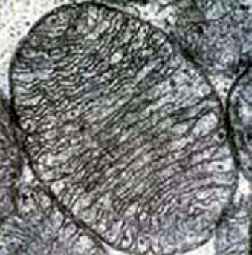
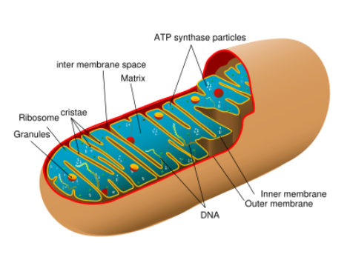
Structure of Mitochondria

Slide 12
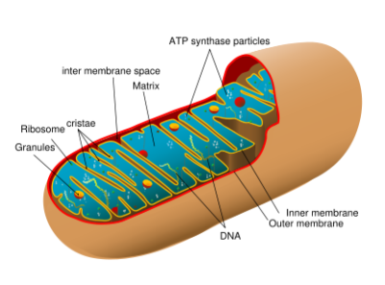
Mitochondrial Outer Membrane
The outer mitochondrial membrane, which encloses the entire organelle, has a protein-to-phospholipid ratio similar to the eukaryotic plasma membrane (about 1:1 by weight). It contains numerous integral proteins called porins, which contain a relatively large internal channel (about 2-3 nm) that is permeable to all molecules of 5000 daltons or less. Larger molecules, for example most proteins, can only traverse the outer membrane by active transport.

Slide 13

Mitochondrial Inner Membrane
The inner mitochondrial membrane is compartmentalized into numerous cristae, which expand the surface area of the inner mitochondrial membrane, enhancing its ability to generate ATP. In typical liver mitochondria, for example, the surface area, including cristae, is about five times that of the outer membrane. Mitochondria of cells which have greater demand for ATP, such as muscle cells, contain more cristae than typical liver mitochondria.

Slide 14
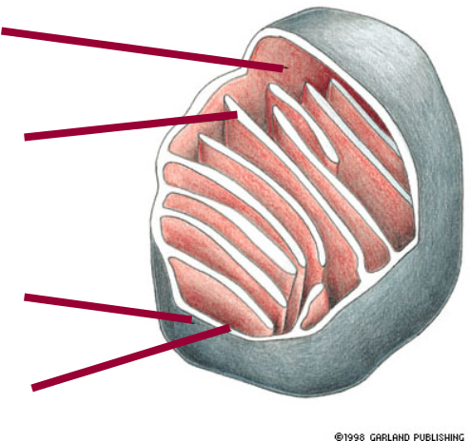
Mitochondria
  Double membrane creates 2 spaces
    Matrix – large internal space
    Intermembrane space – between the membranes
  Outer membrane
  Inner membrane

Slide 15
The Functions of mitochondria
1- Those that perform the redox reactions of oxidative phosphorylation.
2- ATP synthase, which generates ATP in the matrix.
3- Specific transport proteins that regulate metabolite passage into and out of the matrix.
4- Protein import machinery.

Slide 16
Oxidative phosphorylation
Metabolites are degraded within mitochondria by the catalytic activity of the enzymes of the citric acid cycle, and the energy liberated in this process is partially captured through oxidative phosphorylation.

Slide 17
●About 50% of this energy stored as high- energy phosphate bonds in ATP molecules.
●The remaining 50% is dissipated as heat used to maintain body temperature.

Slide 18
Oxidative phosphorylation
lipids Proteins Carbohydrates
Acetyl-CoA
(common intermediate )
Citric Acid Cycle
Electron Transport and
Oxidative Phosphorylation
CO2 + H2O + ATP
The energy stored in ATP can be released by hydrolysis to ADP:
outside mitochondria
ATP + H2O
ADP + Pi + Energy
inside mitochondria

Slide 19
Mitochondrial Pathogenic
●Diseases generally have been thought of as a spectrum of primarily inherited conditions afflicting roughly 1 in every 2,000–5,000 people.
●About 1 in 200 people in the general population are thought to carry potentially pathogenic mitochondrial DNA mutations.

Slide 20
Golgi Apparatus (complex)
Ass.prof.Dr.Emad Kudhair Abbas
PhD Molecular cytology

Slide 21
Definition
The name comes from Italian anatomist Camillo Golgi, who identified it in 1898. The highly dynamic Golgi apparatus completes post translational modifications and then packages and addresses proteins synthesized in the RER. Golgi complex is composed of smooth membranous saccules in which these functions occur.

Slide 22
The characteristics feature
●Golgi apparatus varies in sized and form in different cell types, but usually has similar organization for any one kind of cells.
●It appears as a coarse network under a light microscope .
Under the EM shows a central stack of parallel, flattened, inter communicating sacs or cisternae and many peripheral tubules and vesicles. ●The cisternae vary in number from three to seven in most animal cells.

Slide 23
●Near the Golgi, the RER can be seen budding off small transport vesicles that shuttle newly synthesized proteins to the Golgi apparatus for further processing.
●Proteins, either within the lumen of a coated vesicle or embedded in its membrane, are transported to the Golgi apparatus from ER.

Slide 24
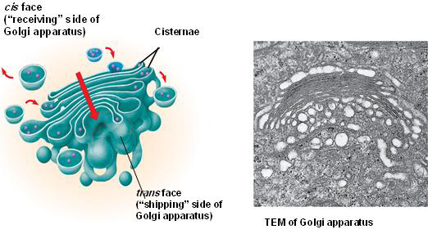
The structure

Slide 25
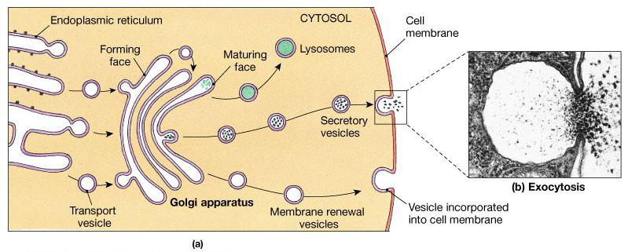

Slide 26
The functions
The TEM and cytochemical methods have shown that Golgi saccules contain different enzymes at different cis-trans levels and that the Golgi apparatus is important for glycosylation, sulfation, phosphorylation, and limited proteolysis of proteins.
●The Golgi apparatus initiates packing, concentration, and storage of secretory products

Slide 27
Golgi apparatus have roles in Manufactures certain macromolecules, like pectin and sialic acid and certain poly saccharides.

Slide 28
Secretory Vesicles or Granules
●These vesicles are surrounded by a membrane and contain a concentrated form of the secretory product.
●The contents of some secretory vesicles may be up to 200 times more concentrated than those in the cisternae of the RER. Secretory vesicles with dense contents of digestive enzymes are referred to as zymogen granules

Slide 29

Ass.prof.Dr.Emad Kudhair Abbas
PhD Molecular cytology

Slide 30
Lysosomes
Lysosomes are simple one membrane bound sacs filled with about 40 different hydrolytic digestive enzymes and are particularly abundant in cells with great phagocytic activity (e.g., macrophages, neutrophils).
Although the nature and activity of lysosomal enzymes vary depending on the cell type, the most common are acid hydrolyases such as proteases, nucleases, phosphatases, phospholipases, sulfatases and ß- glucuronidase.

Slide 31
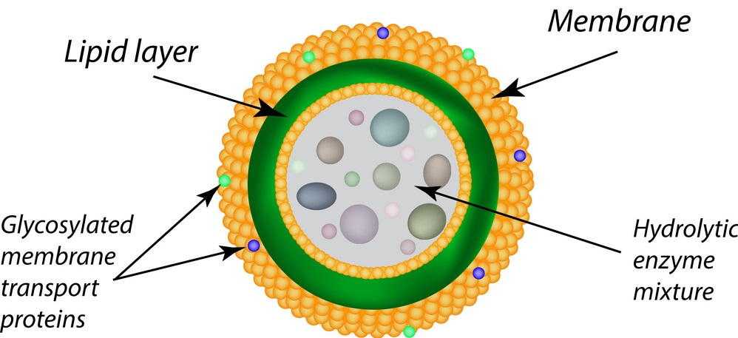
The characteristics feature
Lysosome bounded by a single lipoprotein membrane.
They are globular having a diameter of 0.2 to 0.8 microns.
The lipoprotein membrane insulates the enzymes from the rest of the cell (protected)
optimal activity at an acidic pH (~5).

Slide 32
The functions
Lysosomal enzymes can hydrolyze proteins, fats, polysaccharides, and nucleic acids.
These enzymes are synthesized by the Rough Endoplasmic Reticulum (RER) and then sorted into secretory vesicles (lysosomes) in the Golgi apparatus.

Slide 33
The Morphology
The morphological heterogeneity of lysosomes is attributable in part to the various stages in a dynamic process of intracellular digestion.
Small granules with relatively homogeneous content are called primary lysosomes, an inactive storage form or ready reserve of hydrolytic enzymes not yet involved in digestive events.

Slide 34
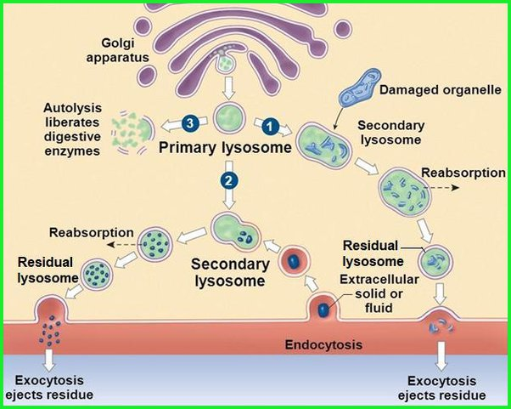
Secondary lysosomes
Somewhat larger bodies with a heterogeneous content that may include recognizable residues of ingested material are heterophagic vacuoles (heterophagolysosomes, or secondary lysosomes) formed by fusion of primary lysosomes with endocytosis vacuoles

Slide 35
lipofuscin pigmented substance
As digestion of the contents of the heterophagic vacuoles progresses, they are reduced in size and become residual bodies mainly contain indigestible lipid materials so it is called (lipofuscin pigmented substances) filled with granules of varying size and density in an amorphous matrix and usually found in old age cells.

Slide 36
Heterolysosomes
The endocytosed material mixes with the hydrolytic enzymes, This composite structure is now termed a secondary or heterolysosome. Heterolysosomes are generally 0.2-2μm in diameter and present a heterogeneous appearance in the TEM because of the wide variety of materials they may be digesting.

Slide 37
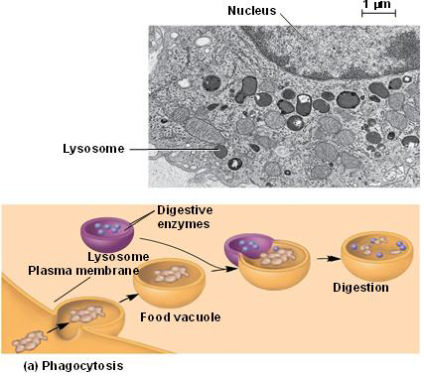
Phagocytosis

Slide 38



Slide 39
Peroxisomes or microbodies
Peroxisomes are similar in appearance to lysosomes, but the two have different origins. Lysosomes are generally formed in the Golgi complex, whereas peroxisomes self-replicate.
Definition
Peroxisomes (microbodies) are spherical, simple membrane-bound vesicle with a diameter of 0.5 um. They utilize oxygen but do not produce ATP and do not participate directly in cellular metabolism.

Slide 40
The characteristics feature
Peroxisomes oxidize specific organic substances by removing hydrogen atoms that are transferred to molecular oxygen.
Peroxisomes contain enzymes for degrading amino acids and fatty acids. These reactions produce a toxic hydrogen peroxide; (H2O2) as a byproduct of cellular metabolism, a substance potentially damaging to the cell which is immediately broken down by catalase.

Slide 41
The characteristics feature
Peroxisomes are multifunctional organelles, containing more than 50 enzymes involved in such diverse activities as the oxidation of very-long-chain fatty acids (oxydase) and the synthesis of plasmalogens (abnormal phospholipid).
The peroxisomes of the liver and kidney are particularly large and abundant, reflecting the functions of these organs in lipid metabolism and management of metabolic waste products.

Slide 42
The main functions of peroxisomes
1- Hydrogen peroxide (H2O2) is a poison, but the peroxisome has enzyme that converts H2O2 to water.
2- Some peroxisomes break fatty acids down to smaller molecules that are transported to mitochondria for fuel.
3- They detoxify alcohol and other harmful compounds, thus, it exists extensively in the liver cells.
4- Initiate the production of phospholipids, which are typically used in the formation of membranes.
5- Peroxisomes also play a role in the production of bile acids and proteins.

Slide 43
Ribosome
Ass.Prof.Dr.Emad Kudhair Abbas
Ph.D. Molecular cytology

Slide 44
What meaning of Ribosome?

Slide 45
Ribosomes
Are the protein synthesis units of a cell described by G.E. Palade in 1952.
Ribosomes are small, electron-dense particles, found in the cytosol and composed of four segments of rRNA and approximately 80 different proteins.

Slide 46
The structure of Ribosome
In eukaryotes, the ribosomes are (20 – 30) nm, and in prokaryotes (including mitochondria)they are slightly smaller.
In both types of cells, ribosomes are composed of two subunits, one large and one small. The two subunits come together by binding an mRNA strand, and typically numerous ribosomes are present on an mRNA as polyribosomes (polysomes).

Slide 47
The number of ribosomes in a cell varies depending on its functions, for example, pancreatic cells and those of other glands have many ribosomes because they produce secretions that contain proteins.

Slide 48
Locations
Eukaryotic cells:
some ribosomes occur freely within the cytoplasm like in (lymphocytes, embryonic nerve cells and cancerous cells) or in groups called polyribosomes, and others are attached to the endoplasmic reticulum (ER) like in (pancreatic cells, plasma cells, hepatic parenchymal cells, adult nerve cell (Nissls bodies) and osteoblasts.
prokaryotic cells:
The ribosomes often occur freely in the cytoplasm or sometimes as polyribosome.

Slide 49
What the function of Ribosome?

Slide 50
The function
1-Proteins synthesized for use within the cell cytosol .
2-Polyribosomes that are attached to the membranes of the endoplasmic reticulum.

Slide 51
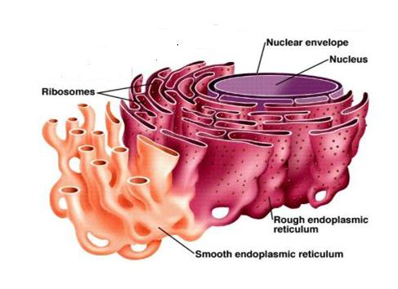
Endomembrane system

Slide 52
Rough endoplasmic reticulum (RER)
RER consists of:
Saclike parallel stacks of flattened cisternae, limited by membranes that are continuous with the outer membrane of the nuclear envelop.
Enzymes that can add carbohydrate (sugar) chains to proteins, and then these proteins are called glycoproteins.
Is prominent in cells specializes for protein secretion, such as pancreatic acinar cells (digestive enzymes), fibroblasts (collagen), and plasma cells (immunoglobulins).

Slide 53
Smooth endoplasmic reticulum (SER)
●Which is continuous with rough ER.
●Does not have attached ribosomes.
●Certain organs contain an abundance of smooth ER and its function depends on the organ. In some organs, smooth ER is associated with the production of lipids. For example, in the testis, smooth ER produces testosterone, a steroid hormone. In the liver, smooth ER helps detoxify drugs.

Slide 54
The functions of smooth ER
1-The smooth ER serves a number of different purposes. It is responsible for protein translation.
2-The smooth ER also helps in the production and storage of glycogen, triglycerides, steroids, and other macromolecules.
3-The smooth ER is important to muscle cells. It stores and regulates the calcium ions in the muscle cells.
4-The smooth ER synthesizes membrane phospholipids which go inward from the endoplasmic reticulum to the nuclear membrane to replace it.

Slide 55
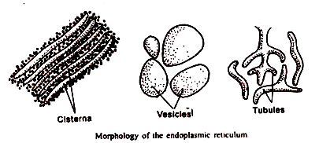
The endoplasmic reticulum forms
1- Lamellar form or cisternae
-fluid-filled sac
-long ,flattened, sac-like, unbranched tubules
2- Vesicular
oval, membrane-bound vacuolar structures. -
3- Tubular
The tubules are branched structures forming the reticular system along with the cisternae and vesicles, occur almost in all the cells.

Slide 57
Centrosome
Centrosome is a zone of cytoplasm, usually centrally located in the cell adjacent to the nucleus and often surrounded by the Golgi apparatus.
The centrosome acts as a nucleation center for microtubules which radiate from here towards the cell periphery. It contains a pair of centrioles embedded in a matrix of tubulin subunits, and are arranged with their long axes at the right angles to each other.

Slide 58
Centrioles
Are rod-shaped bodies near the nucleus that functions in cell division. They help to organize the cell and divide the cell contents during this process.
Centrioles act as microtubule organizing center for the microtubules of the spindle which controls distribution of chromosomes to the daughter cells .

Slide 59
The Structure of centriole
Each centriole is cylindrical in form, consisting of nine triplets of parallel microtubules. The pattern is so named because a ring of nine microtubules (triplets) are arranged at right angles to one another.
Each triplet consist of an inner (complete) microtubule (A), which is circular in cross section, and two further (incomplete) microtubules (B and C), which are C shaped

Slide 60
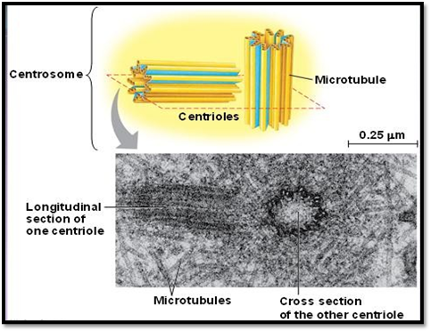
The Structure of centriole

Slide 61
Ultrastructure of the centriole

Slide 62
Centrioles and basal bodies
Basically these are the same thing; a centriole is made up of nine (9) sets of triplet microtubules. A centriole is commonly found in the centrosome.
The centriole is a short cylinder-like structure while Basal bodies are commonly found just beneath the plasma membrane.
Centrioles seem to determine the position of the pericentriolar material, which in turn affects the polarity of the cell.

Slide 63
Basal body and centriole structure

Slide 64
Thank you

